Slide 1

Weapon Detection in Airport in CCTV Surveillance videos Using YOLO and RCNN
TEAM NO:8
MLA0430-Deep Learning
Guided by
Dr.A.M.Arul Raj
Professor
SIMATS Engineering
Presented by:
D.Philip(192425348)
G.Venkata Sai(192425388)
P.Uday Kumar Reddy(192425343)
P.Surendra Kumar Reddy(192425224)
Notes:
1
1

Slide 2
Abstract
Manual monitoring of multiple CCTV cameras is time-consuming and may lead to delayed identification of suspicious activities.
Deep learning techniques automate weapon detection by analyzing live video frames with high accuracy and speed.
YOLO performs real-time object detection, while R-CNN provides accurate classification and localization of detected weapons.
The proposed system generates instant alerts, helping security personnel respond quickly and improve airport safety.

Slide 3
Aim and Objective
Aim
Develop an intelligent surveillance system capable of detecting weapons from airport CCTV video streams in real time.
Objectives
Detect weapons such as pistols and knives using deep learning-based object detection models.
Improve detection accuracy while reducing false alarms in crowded airport environments.

Slide 4
Introduction
Airport surveillance systems continuously monitor passenger movement to detect suspicious activities and maintain public safety.
Human operators may miss critical events due to fatigue, limited attention, or the large number of CCTV cameras.
Deep learning enables automatic identification and localization of dangerous objects in surveillance videos.
YOLO offers fast detection suitable for live monitoring, whereas R-CNN improves detection accuracy through detailed region analysis.

Slide 5
Literature Review & Requirement Analysis
S.No | Year of Publication | Author | Title of the Journal / book | Methodology used | Algorithm used | Key Findings
1 | 2024 | A. Sharma | Real-Time Weapon Detection in Surveillance Videos | Deep Learning-based Object Detection | YOLOv8 | High detection accuracy with real-time performance in CCTV surveillance.
2 | 2024 | S. Patel | Airport Surveillance Using AI-Based Weapon Detection | Video Analytics & Object Detection | YOLO + Faster R-CNN | Hybrid approach improved precision, recall, and overall detection accuracy.
3 | 2023 | J. Redmon et al. | YOLO: Real-Time Object Detection for Security Applications | Single-stage Object Detection | YOLOv7 | Faster detection speed with low latency for live surveillance systems.

Slide 6
Problem Statement
Existing airport surveillance systems mainly depend on manual monitoring, making continuous observation difficult.
Security personnel may fail to identify hidden or fast-moving weapons during crowded situations.
Delayed detection increases response time and may compromise passenger safety.
There is a need for an automated AI-based system capable of detecting weapons accurately in real time.

Slide 7
Existing System
Security staff continuously observe CCTV footage to identify suspicious objects or activities manually.
Human monitoring is prone to fatigue, reduced concentration, and delayed responses during long working hours.
Traditional computer vision methods struggle under varying lighting conditions and crowded environments.

Slide 8
Proposed System
Live CCTV video is continuously captured and divided into individual image frames for processing.
YOLO detects potential weapons quickly by predicting object locations in a single pass.
R-CNN verifies detected objects and refines bounding boxes for higher localization accuracy.
Whenever a weapon is confirmed, the system immediately sends alerts to airport security personnel.

Slide 9
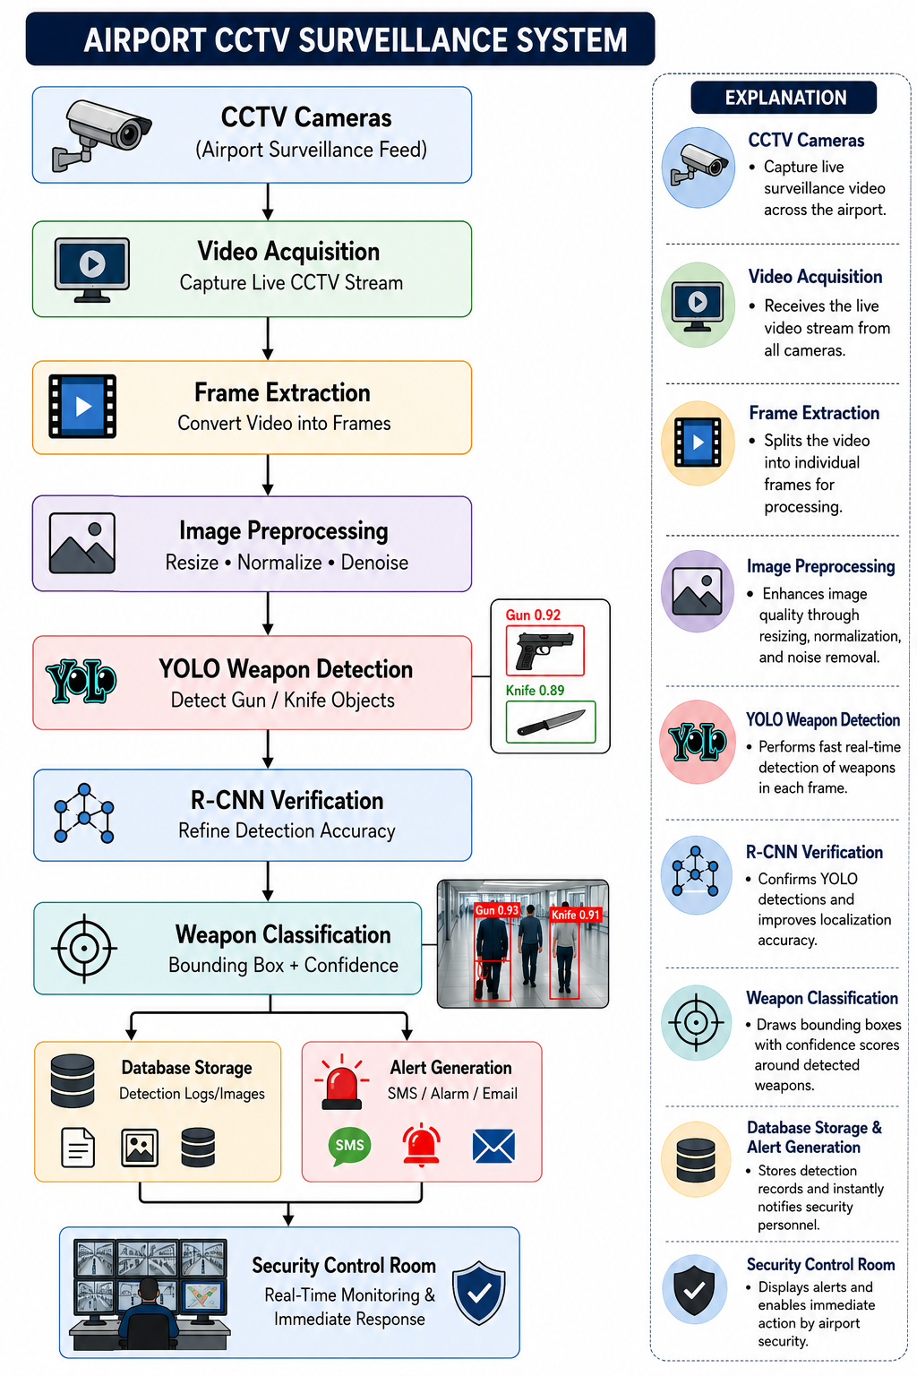
Overall System Architecture Design

Slide 10


Sustainable Development Goal (SDG) Implementation
SDG 16 – Peace, Justice and Strong Institutions
Improves public safety by detecting dangerous weapons before security incidents escalate.
Supports airport authorities in maintaining secure transportation infrastructure.
Reduces crime risks through continuous AI-based surveillance and rapid response.
Strengthens law enforcement capabilities using intelligent monitoring technologies.

Slide 11
Proposed Methodology and Algorithm
Algorithm
YOLO (You Only Look Once)
Region-Based Convolutional Neural Network (R-CNN)
Proposed Methodology
Capture live CCTV video, extract frames, and preprocess images using resizing, normalization, and noise removal.
Detect weapons using YOLO and verify detections with R-CNN to improve accuracy and reduce false positives.
Generate real-time alerts, store detection logs in the database, and notify airport security for immediate action.

Slide 12
Design & Module Planning
M1 – CCTV Video Acquisition & Image Preprocessing
Captures live CCTV video, extracts frames, and preprocesses images to improve detection quality.
M2 – Weapon Detection Using YOLO
Detects weapons such as guns and knives in video frames quickly using the YOLO object detection algorithm.
M3 – Weapon Verification Using R-CNN
Verifies YOLO detections by refining object localization and reducing false positive detections.
M4 – Alert Generation, Database Storage & Security Notification
Generates real-time alerts, stores detection results in the database, and notifies airport security personnel immediately.

Slide 13
M1 – CCTV Video Acquisition & Image Preprocessing
Collect continuous video streams from airport surveillance cameras for real-time monitoring.
Convert the captured video into individual image frames for detailed analysis.
Resize each frame to the input size required by the YOLO and R-CNN models.
Apply normalization and noise removal techniques to improve image quality.
Prepare the processed frames for accurate weapon detection and classification in the next module.

Slide 14


M2 – Weapon Detection Using YOLO
Detects weapons such as guns and knives in the preprocessed CCTV video frames.
Identifies the location of each weapon by drawing bounding boxes around detected objects.
Predicts confidence scores to indicate the accuracy of each detection.
Processes multiple objects in a single frame with high speed for real-time surveillance.

Slide 15
M3 – Weapon Verification Using R-CNN
Verifies the weapons detected by the YOLO model to improve detection reliability.
Refines the bounding boxes for more accurate localization of detected weapons.
Reduces false positives by distinguishing weapons from similar-looking objects.
Confirms the type of detected weapon using region-based feature extraction.

Slide 16
M4 – Alert Generation, Database Storage & Security Notification
Generates real-time alerts immediately after a weapon is verified by the detection system.
Stores detection details, images, timestamps, and confidence scores in the database.
Sends instant notifications to the airport security control room for rapid response.
Displays the detected weapon with bounding boxes and confidence scores on the monitoring screen.

Slide 17
Conclusion
The proposed system combines YOLO and R-CNN to provide fast and accurate weapon detection in airport CCTV surveillance.
YOLO enables real-time object detection, while R-CNN improves localization and classification accuracy.
Automated detection reduces manual monitoring effort and minimizes response time during security incidents.
The system enhances passenger safety and supports airport security personnel with intelligent decision-making.

Slide 18
References
Shanthi, P., and V. Manjula. "A systematic review on CNN-YOLO techniques for face and weapon detection in crime prevention." Discover Computing 28.1 (2025): 204.
Sandhu, Simratjit kaur, and Rekha Bhatia. "A Review of Visible and Concealed Weapon Detection Techniques Using Machine Learning and Deep Learning." SN Computer Science 6.6 (2025): 611.
Alamri, Faisal. "Comprehensive study on object detection for security and surveillance: A concise review." Multimedia Tools and Applications 84.34 (2025): 42321-42352.

